Slide 1
CS451R Group 6 Presentation
Tarik Salay, David Tran, Jonathan Wolfe
University of Missouri - Kansas City

Slide 2
Introduction
Group 6
David Tran: Project Manager
Jonathan Wolfe
Tarik Salay

Slide 3
Tech
Top Tier:
Web Browser
Business Tier:
Application Layer: C# ASP.NET Core MVC
Data Layer: .NET Connector
Database Tier:
MySQL

Slide 4
Deficiencies
Option To Hide Alerts When There Are No Alerts
Pull Alerts Over Different Time Frames

Slide 5
Stretch Goals / Future Plans
Sorting & Searching
Data Paging
Mobile Support
Americans With Disabilities Act Compliance
Specific Design Elements and Images

Slide 6
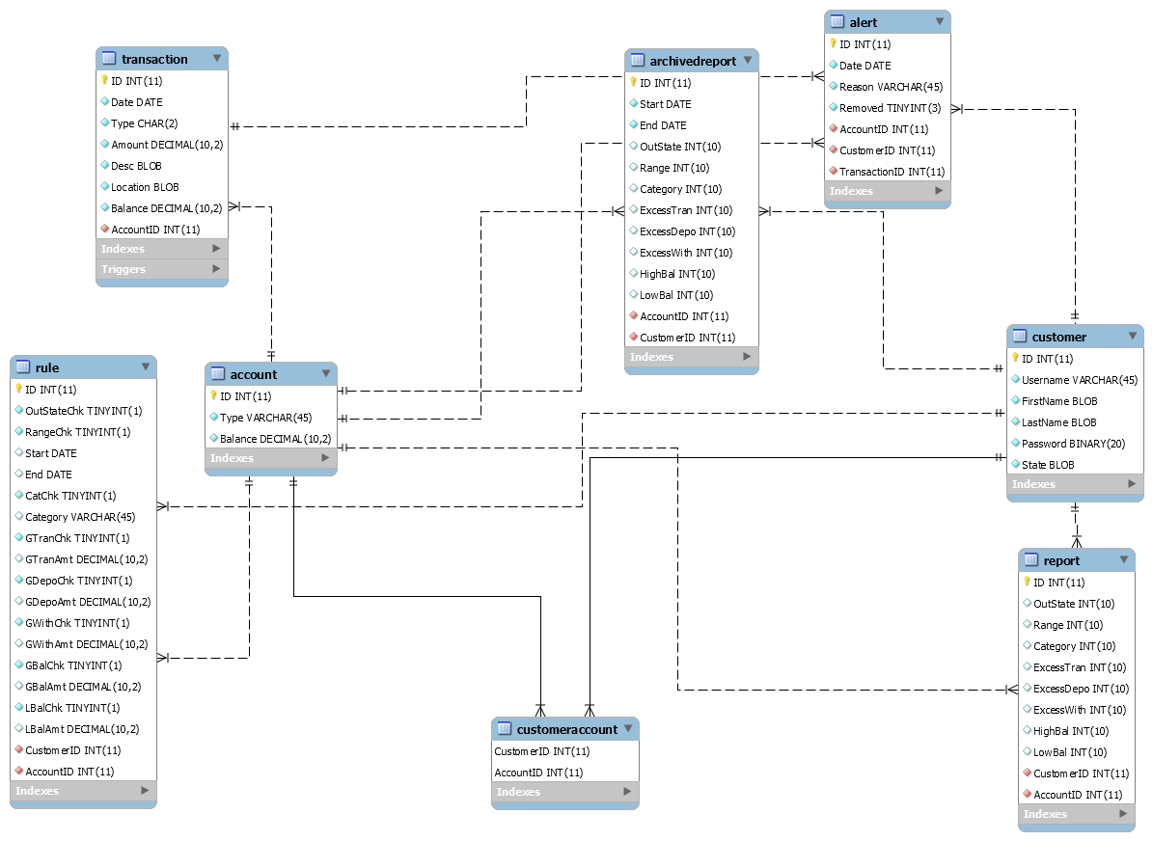
Database Diagram

Slide 7
Alert Triggering and Reporting
Every Transaction Is Checked If It Qualifies As An Alert
Checks Are Based On The Currently Set Rules For Each Customer Holding The Account
Rules Listed On Top Of the Rules List On The Rules Page Are Checked First
Transactions Triggering An Alert Are Stored In An Alerts List
Creating An Alert Also Increases A Counter For The Alert Type In The Currently Monthly Report

Slide 8
Monthly Report Generation
Every 30 Days, Information From The Current Monthly Report Is Archived
Counts Of Alert Types Are Made Into An Archived Report
The Start And End Date Is Also Added To This Report
This Report Is Then Added To An Archived Report List
Counts Of Each Type Of Alert Are Then Reset To 0 For The Current Monthly Report

Slide 9
Database Security
SQL Injection
Parameterized User Input Into Stored Procedures
Hashed Passwords
SHA1 With Salt
AES Encryption
Customer Name And Home State
Transaction Description And State

Slide 10
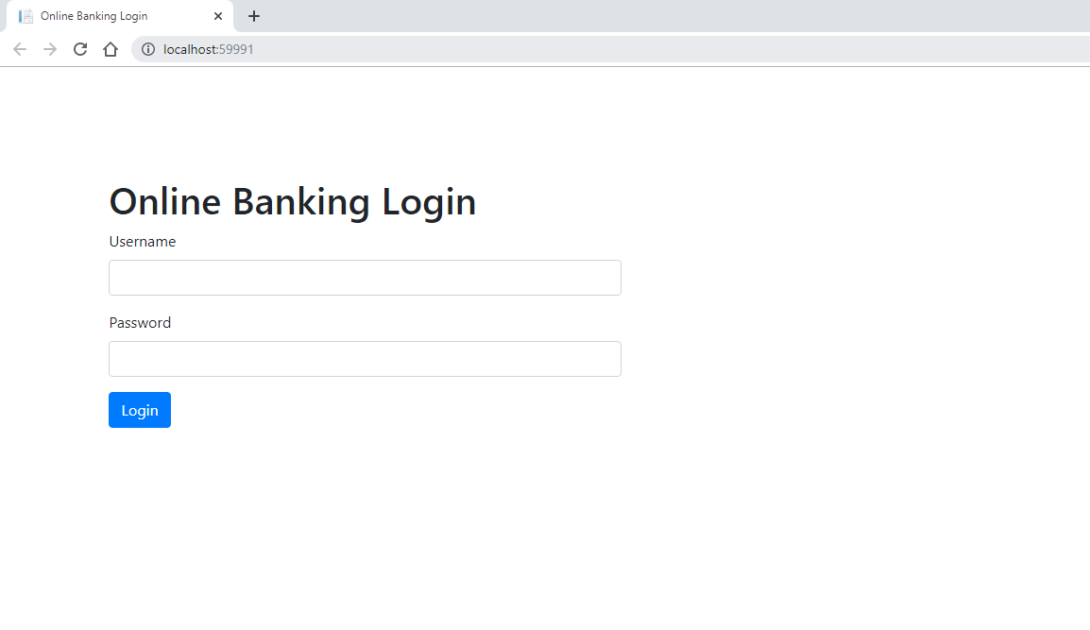
Login
Notes:
a1
Show Failed Login
Assume Logins from Bank ( No Registering )

Slide 11
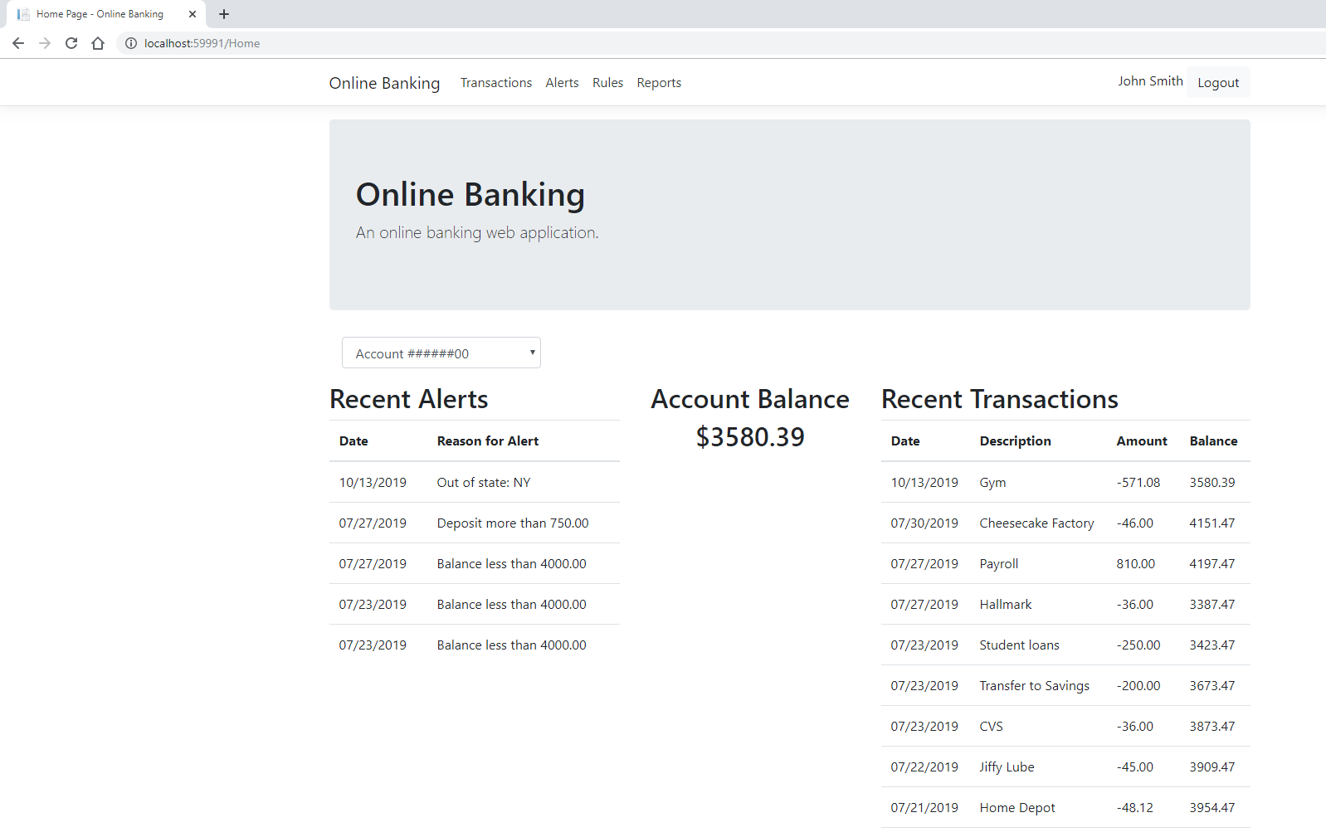
Home
Notes:
Multiple Account Numbers (correlating infor changes)
Current Balance
Recent Transactions [Top 10] => Reverse Order
Recent Alerts [Top 5]
Navigation Bar

Slide 12
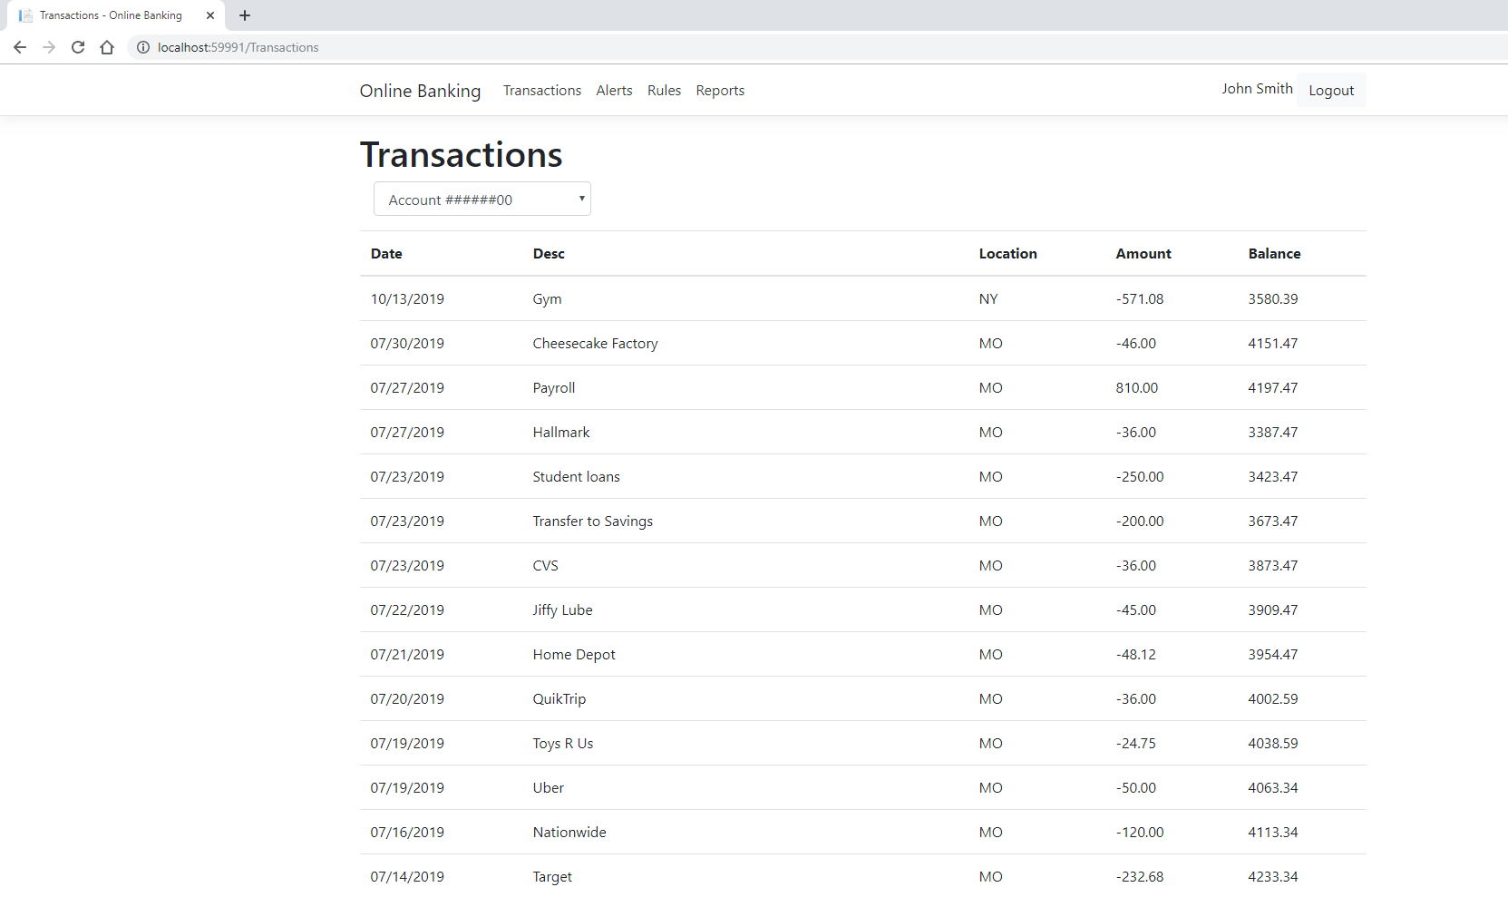
Transactions
Notes:
Multiple Account Numbers (correlating infor changes)
Date
Description
Location (State)
Amount (negative if Withdrawal)
Balance at the time of Transactions

Slide 13
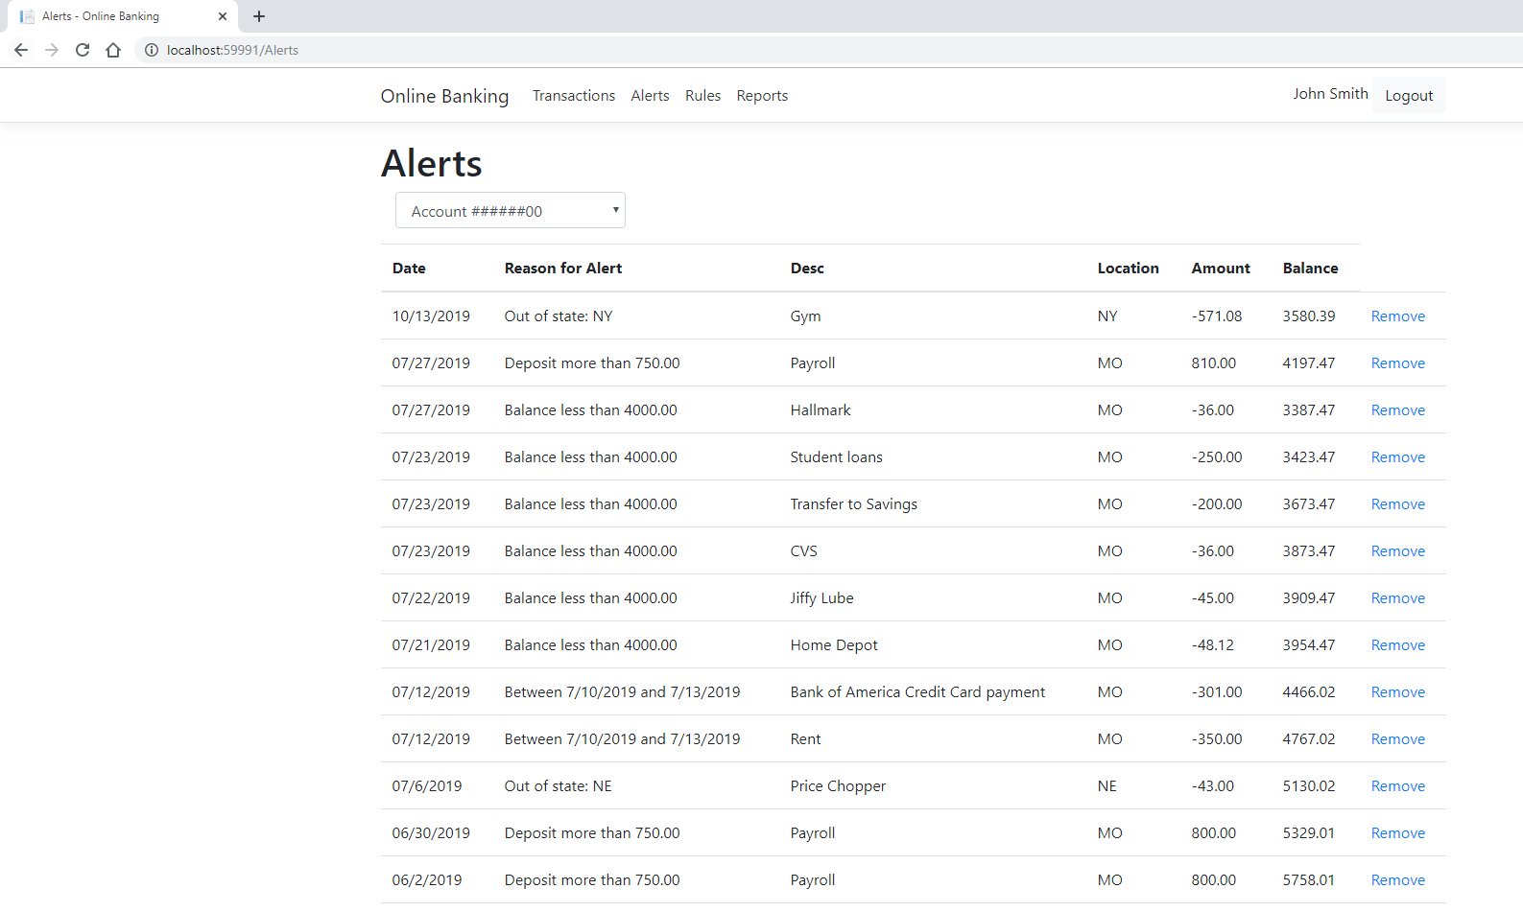
Alerts
Notes:
Multiple Account Numbers (correlating infor changes)
Date
Reason for Alert
Transaction Information
Remove Button
=> Correlates to Rules Made

Slide 14
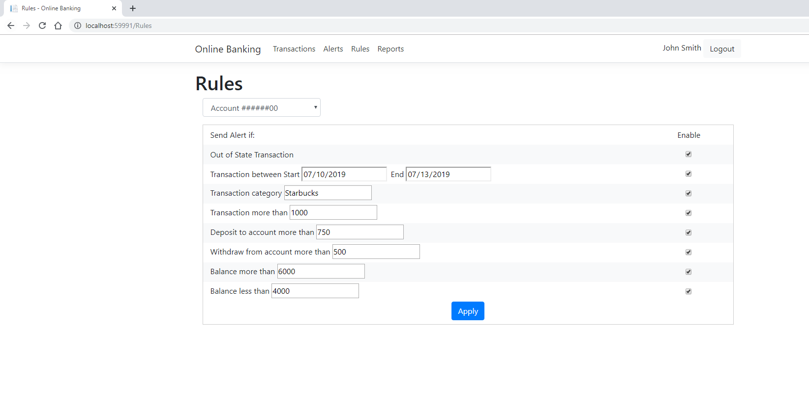
Rules
Notes:
Automatically Generate

Slide 15
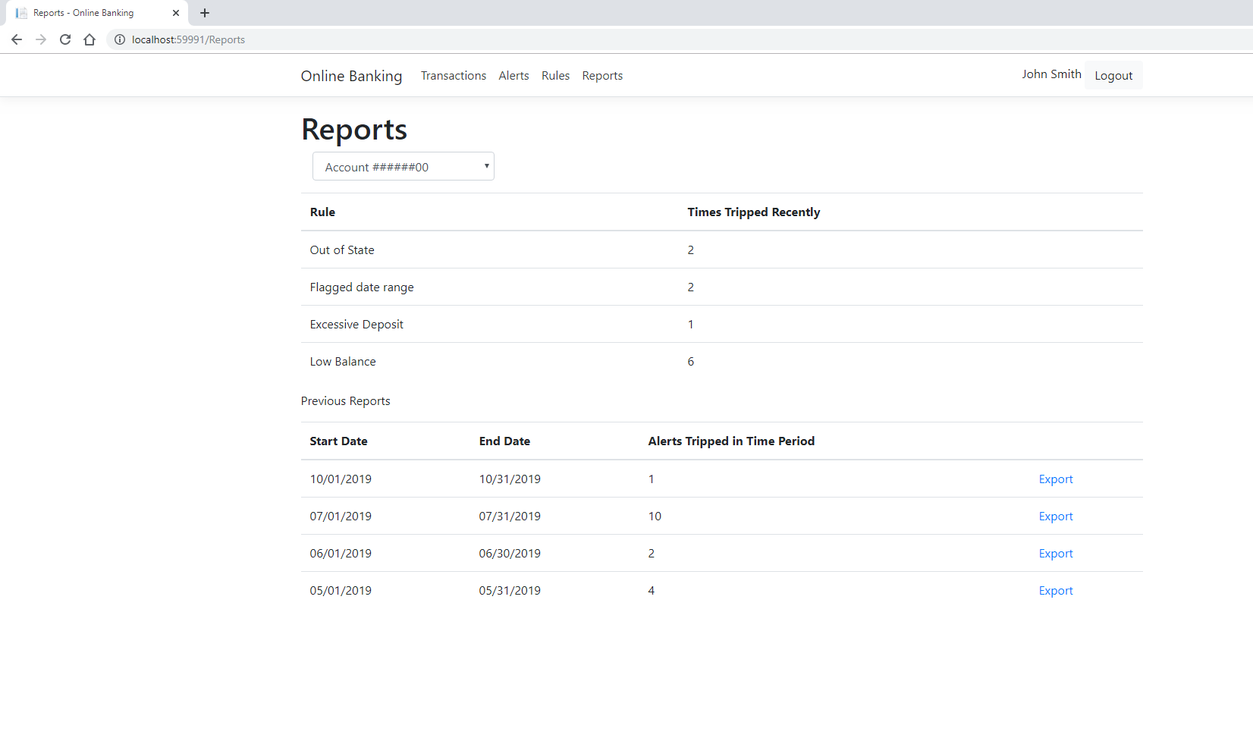
Reports
Notes:
Reports of Recent Alerts

Slide 16
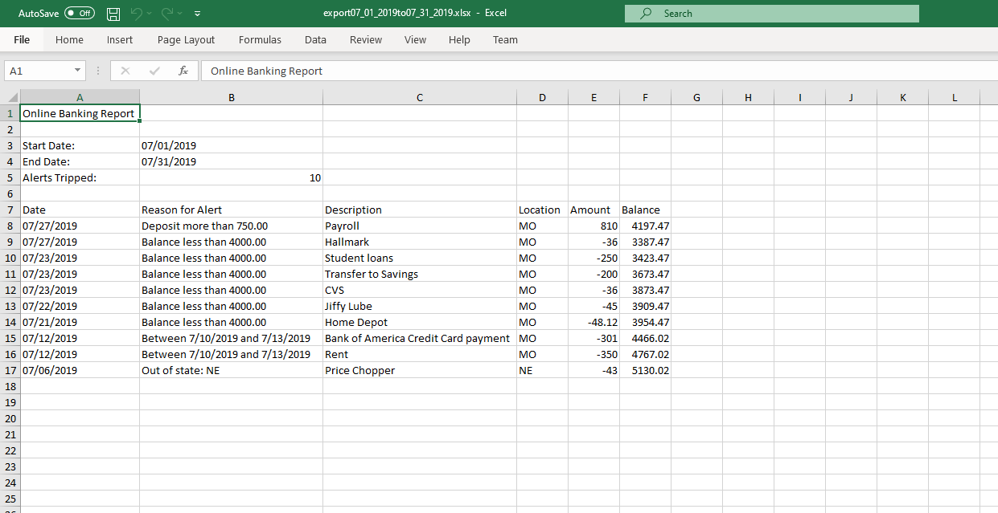
Reports Export File
Notes:
Straightforward
Full transaction data

Slide 17
Creating Alerts with New Rules
CALL cs451_project.addTransaction('2019-12-5', 'DR', 5.99, 'McDonalds', 'MO', 12341000);
CALL cs451_project.addTransaction('2019-12-5', 'DR', 2.99, 'Starbucks', 'AZ', 12341000);
CALL cs451_project.addTransaction('2019-12-5', 'DR', 2500.00, 'Bookstore', 'MO', 12341000);
CALL cs451_project.addTransaction('2019-12-6', 'DR', 14.99, 'Gym', 'MO', 12341000);
Notes:
Change Rules
Show Change in Transactions/Alerts/Balance

